Slide 1
Predicting Obesity Using Health Behaviour and Sociodemographic Data
Chantelle, David-Dan, Jemal

Slide 2
Understanding Obesity Risk in Canada
Obesity rates in Canada are rising, impacting both individual and public health
Exploring how health behaviours and sociodemographic factors influence obesity risk may provide population health analytic data needed for health systems planning
Objectives:
Predict obesity status using health behaviors and sociodemographic factors
Compare the predictive value of health-related-only, demographics-only, and combined models in determining obesity status

Slide 3
Data Engineering & Analysis Approach
Dataset 2: 23,535 participants, complete case analysis (no missing values).
Data Preprocessing:
Removed height and weight (to avoid overfitting).
Features: calorie intake, sugar intake, physical activity, etc., for health-related factors.
Gender recoded (male=0, female=1); BMI categorized as obese (≥30) vs. not obese (<30).
Modeling Approach:
k-Nearest Neighbors (KNN): Used to classify obesity based on demographic and health factors.
Training and testing sets stratified by the outcome (obesity status)
Models:
Primary: Demographic + Health-related factors.
Secondary 1: Demographic features only.
Secondary 2: Health-related features only.
Metrics: Precision, Recall, F1 score, AUC.

Slide 4
Model Performance & Key Takeaways
Class Imbalance: Obesity: 71% non-obese, 29% obese, Gender: 63% female and 37% males
Model Performance:
Conclusions:
Models performed poorly in predicting obesity, with low precision and recall
Best performance came from demographic model (slightly higher F1, recall and AUC)
Clinical limitations: BMI as a measure of obesity can be inaccurate, especially for specific populations (e.g., young, elderly, or those with high muscle mass).
Future Directions: Incorporate more features to increase model variability and improve predictions and address class imbalance further (e.g., penalization methods).
Model | Precision | Recall | F1 | AUC
Main | 0.28 | 0.13 | 0.18 | 0.49
Demographic Only | 0.28 | 0.21 | 0.24 | 0.51
Health-Related Only | 0.29 | 0.15 | 0.20 | 0.49

Slide 5
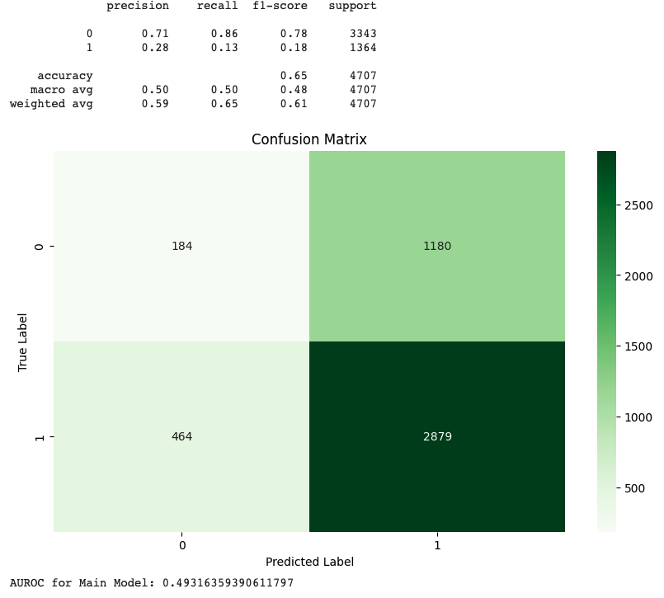
Appendix 1. Confusion matrix and performance of the main model

